Slide 1

Film Analysis by Group 2

Slide 2


Slide 3

Business Understanding
The movie industry has undergone significant changes over the years, evolving considerably over time. This highlights the importance of identifying the types of films that resonate most with audiences around the world today.
Our aim is to perform an analysis that delivers actionable insights, helping the company create films in which success is imminent.

Slide 4
Main Objective
To determine the best performing movie genres on the market.

Slide 5
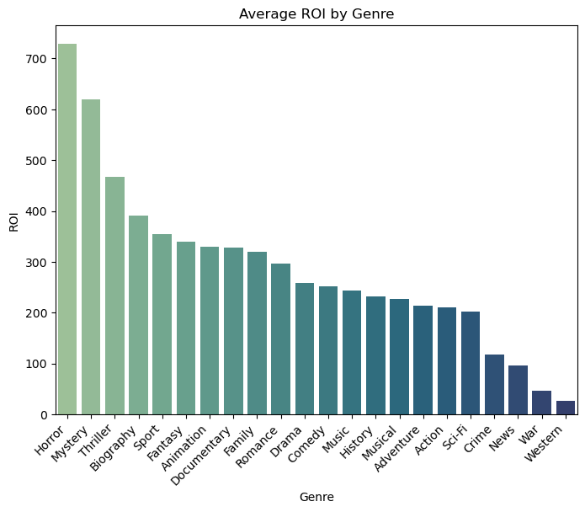

Slide 6
Findings
As per the previous slide, it is evident that Horror movies, yes, horror movies have the highest return on investment as compared to the other genres.
They are closely followed by Mysteries, Thrillers and then Biographies. This occurs because these movies often have small budgets but achieve high ROI due to their particular audience and lower production costs.

Slide 7
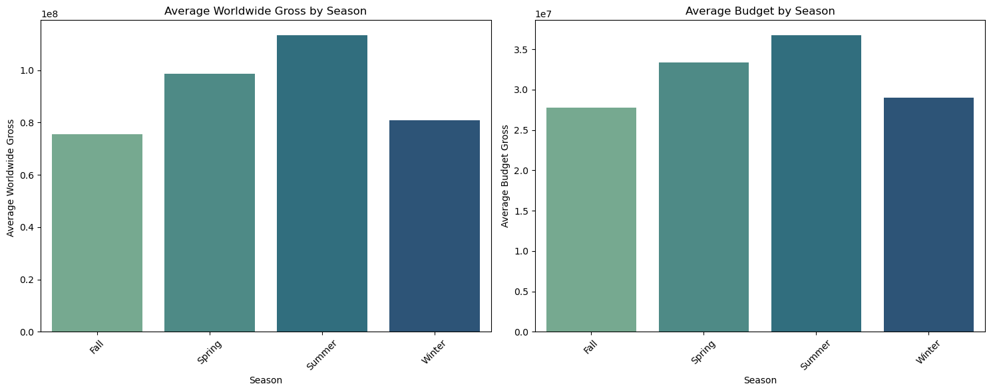

Slide 8
Findings
It is apparent that movies released in the summer are of have the highest budget allocations, as well as the highest worldwide gross.
This can be attributed to the fact that summer coincides with school holidays and family vacations in many parts of the world, making it excellent for primetime viewership.
This translates to studios allocating higher budgets to attract large audiences, ensuring a better return on investment.

Slide 9
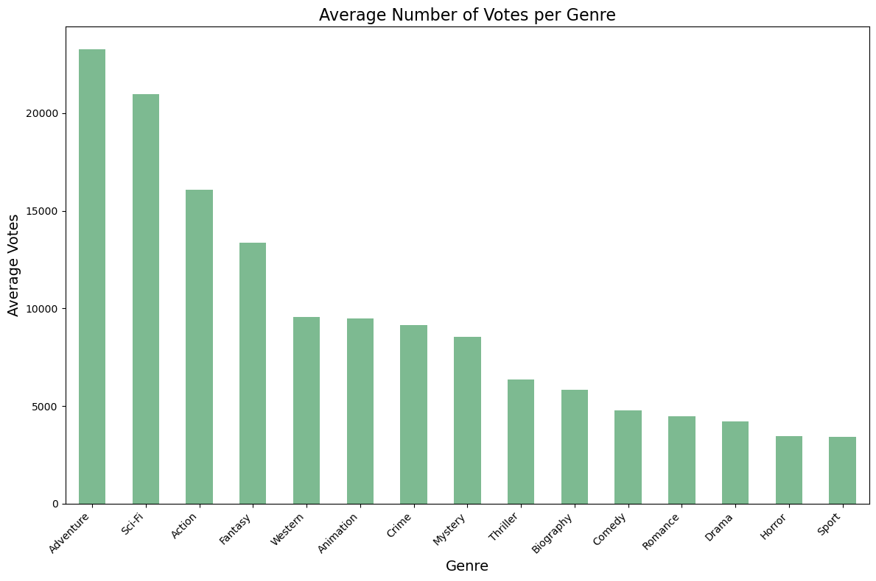

Slide 10
Findings
Adventure, Sci-fi, Action and Fantasy are just but a handful of genres that top the list in votes per genre, portraying their popularity amongst audiences worldwide.
These genres often feature visually appealing special effects, action sequences, as well as creative settings making them ideal for the big-screens.

Slide 11
Recommendations
Recommendations to capitalize on the never ending popularity of Adventure, Sci-Fi, Action, Fantasy etc:
Developing original stories and adaptations of successful novels, comics, or games in these genres.
Ensuring visually appealing designs and groundbreaking special effects to elevate audience experiences.
Allocating significant budgets to ensure production quality, especially in Sci-Fi and Fantasy themes.
Audiences are often drawn to unique, immersive worlds and innovative storytelling

Slide 12
Cont…
Recommendations to capitalize on the high ROI of horror movies and other similar genres:
Focus on low to mid-budget productions as these genres excel with smaller budgets, reducing financial risk while still achieving high returns.
Putting emphasis creative storytelling audiences are drawn to psychological depth, suspense, and originality in these genres
Release during off-peak seasons because these genres perform best outside blockbuster-dominated seasons, therefore avoiding competition with big-budget films.

Slide 13
Cont…
Recommendations for maximizing success with summer movie releases:
Focus on blockbuster genres because summer audiences expect action-packed, visually stunning, and family-friendly content
Increase budget allocation as summer movies typically generate the highest worldwide gross, justifying higher production and marketing investments.
Schedule prime release dates as timing can make or break a summer release, targeting peak weekends, perhaps in which public holidays are frequent
Avoid clashing with established franchise releases or other highly anticipated films.

Slide 14

Authors: Felix Mwendwa, Acinath Onkendi, Kago Ruburu, Lisa Mwangi, Simon Ndichu, Vincent Mutuku

Slide 15


